Slide 1
A NOVEL APPROACH OF
NOISE SUPPRESSION IN AUDIO
Under the guidance of
Dr. Y RAGHAVENDER RAO
(Professor and Head of the department )
BY:
P SAI SANDEEP (17SS1A0438)
ALOKE VISHWAKARMA (17SS1A0403)
SEGGARI KOUSHIK (17SS1A0449)

Slide 2

MOTIVATION
We come across various scenarios where presence of noise distorts the speech or audio signal.
This additive noise makes a deleterious effect on audio signals and reduces the intelligibility of the audio signal.

Slide 3
AIM
To design an approach of removing additive noise from audio signal and preserve useful information in the audio.
OBJECTIVE
Suppress the surrounding noise to maximum possible extent
To Enhance the Signal to noise ratio(SNR) of speech signal to attain maximum possible efficiency.

Slide 4
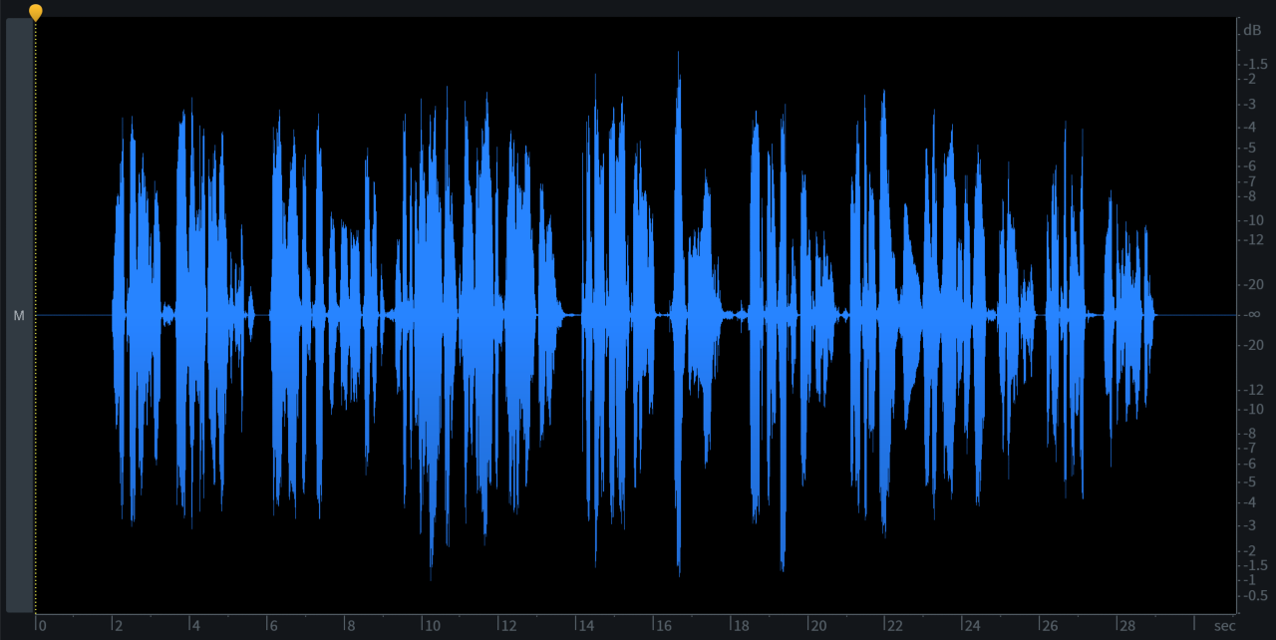
INTRODUCTION
Speech signal is often degraded by surrounding noise.
In human - machine communication, speech is not often preferred due to the influence of noise.
FACTORS AFFECTING THE PERFORMANCE:
Surrounding noise
Echo
Reverberation
Amplitude
Time

Slide 5
SPEECH ENHANCEMENT TECHNIQUES
SPECTRAL SUBTRACTION ALGORITHM
The noise spectrum is estimated during speech pauses and is subtracted from the noisy speech spectrum to estimate the clean speech. The spectral subtraction method is a classical approach for enhancement of speech corrupted by additive noise.
WEINER FILTERING ALGORITHM
The amplitudes of the noisy signal is modified by multiplying the noisy signal with the gain the signal.

Slide 6
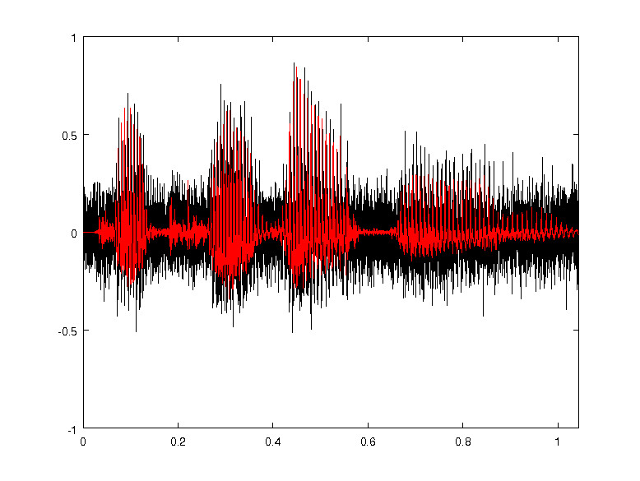
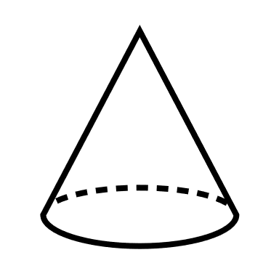
SPECTRAL SUBTRACTION ALGORITHM
Noise
Speech signal
Noisy speech signal
Noisy speech signal Y(n) is sampled.
Choose a sample where only noise is present.
Estimate the time averaged noise spectrum.
Y(n) x(n) d(n)
Speech
Noise
Amplitude
Time

Slide 7
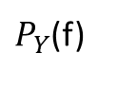
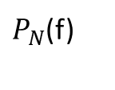


BLOCK DIAGRAM
E {|N(f)|}
FFT
Y(f) = X(f) + N(f)
NOISE ESTIMATION
y(n)
Noisy speech
Amplitude
POWER SPECTRUM
Phase
POWER SPECTRUM
$P_{Y}$(f)
Enhanced speech
IFFT
SQUARE ROOT
x(n)
$P_{N}$(f)
|X(f) |= |y(f)| -$α$(SNR(f)) |N(f)|
$P_{X}$(f) =$P_{Y}$(f) - $P_{N}$(f)

Slide 8
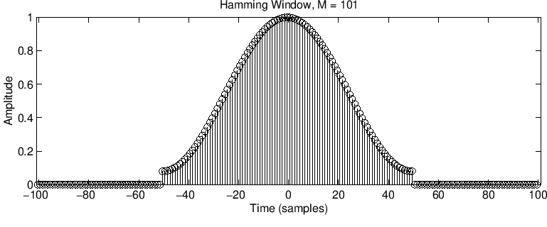
WHY WINDOWING?
In this method, the noisy speech signal is partitioned into samples.
But these samples introduce discontinuities in the noisy speech signal.
To reduce the effect of these discontinuities , WINDOWING techniques are used.
Window used : Hamming Window
Coefficient of Hamming window :
w(n)=0.54−0.46cos(2πn/N), 0≤n≤N
window length L = N + 1

Slide 9
ADVANTAGES
Spectral subtraction method does not require any expected output clean speech signal to measure the accuracy.
It reduces computational complexity and memory requirement.
Maximum signal to noise ratio can be achieved using this method.
DISADVANTAGES
When the clean speech signal is continuous all through the audio, estimation of noise signal will be difficult.
Complete suppression of the noise signal cannot be achieved.

Slide 10
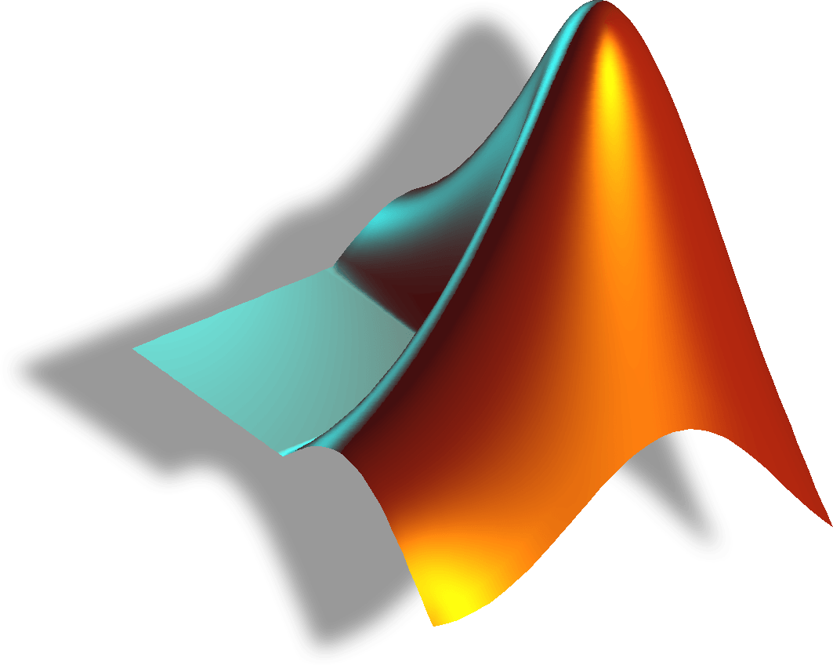
IMPLEMENTATION AND DESIGN
Coding platform :
MATLAB
Why MATLAB?
Large set of built-in functions.
Wide range of plotting and visualization capabilities.
Easy to use and trusted by many.
Spectral subtraction algorithm can be implemented using a combination of in-built functions.

Slide 11
FLOW CHART
Load noisy signal
Extract noise spectrum
Estimate SNR
Compute attenuational map
Compute inverse STFT

Slide 12
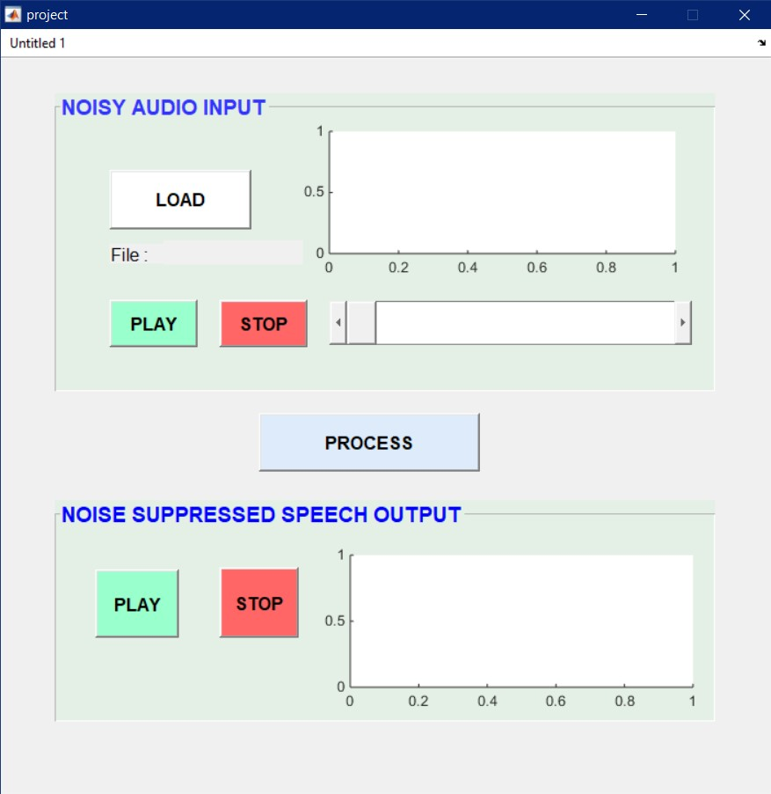
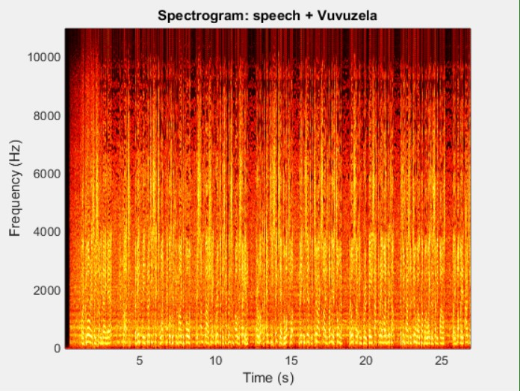
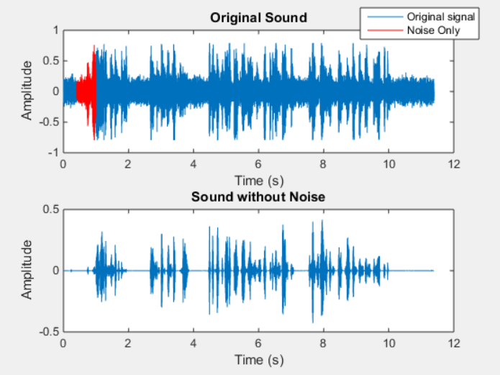
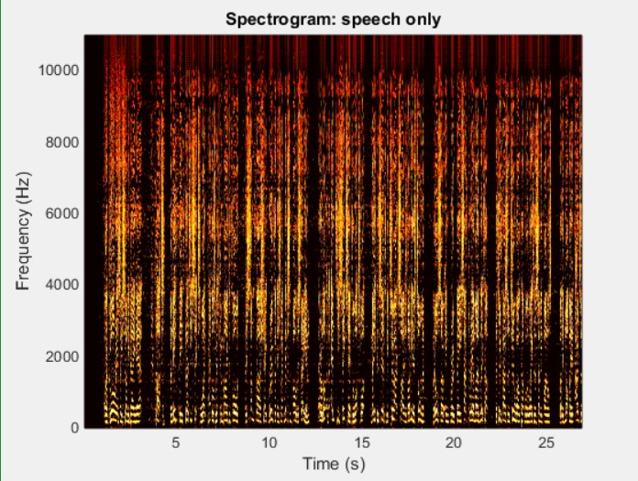
RESULTS AND DISCUSSION

Slide 13


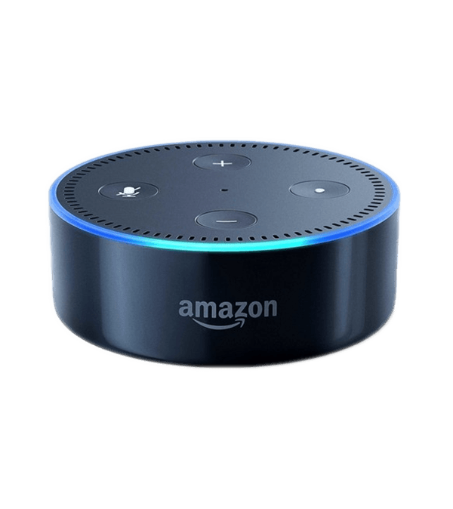


APPLICATIONS
Hearing aids.
Headsets.
Removal of vuvuzela noise.
Communication.
Smart devices.

Slide 14

FUTURE SCOPE
Further research can focus on speech recognition where this method is used as a preprocessor to the speech recognizer.
Echo and reverberation improvisations can be done to improve quality.
Moreover, a research could focus on different choices of filter banks to further improve the performance.

Slide 15
CONCLUSION
We have developed a speech enhancement technique that provides better noise suppression in terms of intelligibility and performance.
Hence, spectral subtraction seems to let us achieve better acoustic noise reduction and does provide more parameters, which we can tune to achieve better results.

Slide 16
REFERENCES
BOOKS
“Suppression of acoustic noise in speech using spectral subtraction” by S.F. BOLL.
“Enhancement of speech corrupted by acoustic noise” by M. Berouti, R. Schwartz and J. Makhoul
Websites
http://practicalcryptography.com/miscellaneous/machine-learning/tutorial-spectral-subraction/
https://www.sciencedirect.com/science/article/pii/S1877050915013903
https://blogs.mathworks.com/loren/2010/06/30/vuvuzela-denoising-with-parametric-equalizers

Slide 17
THANK YOU
FOR YOUR TIME

